Slide 1

Module 2
Binary Classification
Notes:
Guidelines
Use section headers to chunk content in your presentation.
Use the same style of section header throughout your presentation.
Keep your title to no more than 2 lines.

Slide 2
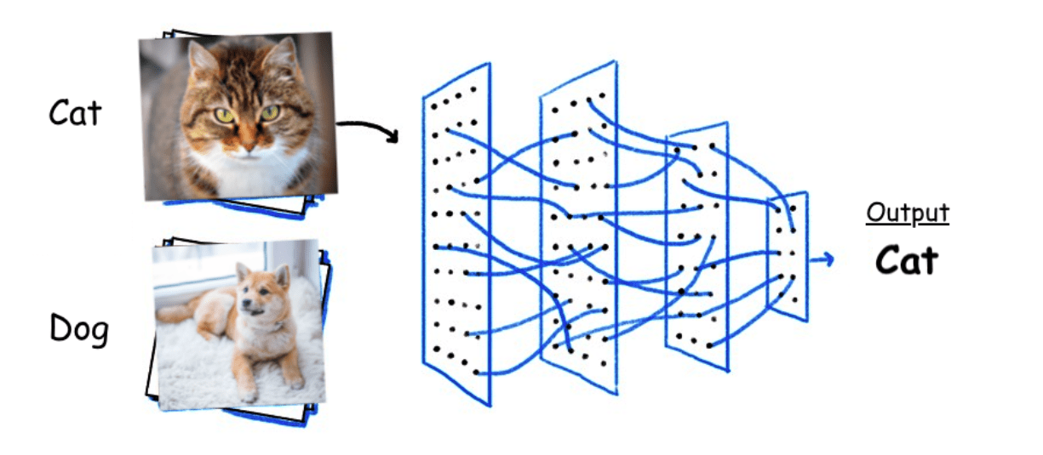
Binary Classification
Notes:
Guidelines
Use a title slide at the beginning of your presentation. There are 9 variations of title slides to choose from.
If you will have a series of slideshows, we recommend using the same style of title slide for each presentation.
Keep your title to no more than 2 lines.
Do not change the font style or font size of the title or subtitle.

Slide 3
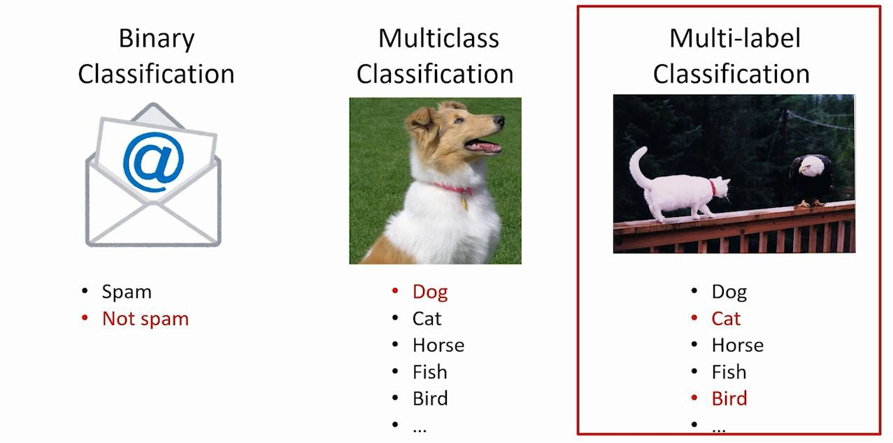
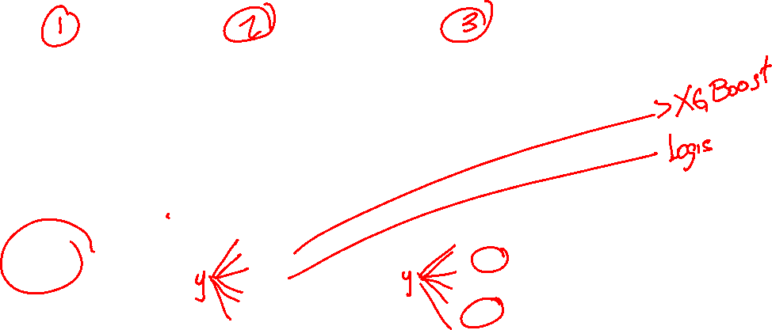
Types of Classification Problems
The 3 main classification problems are:

Slide 4
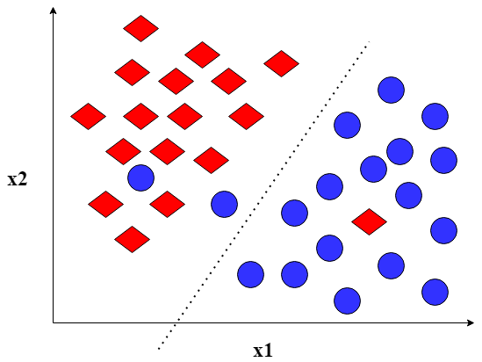
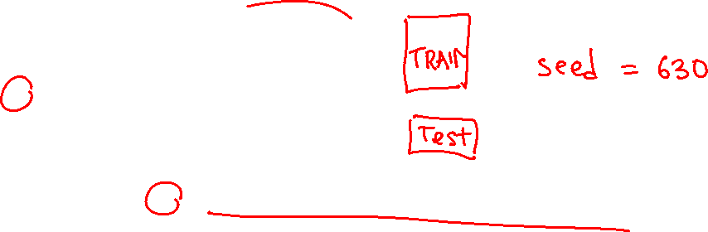
Binary Classification
is the task of classifying the elements of a set into one of two groups (each called class).
Separating Hyperplane
LINEAR

Slide 5
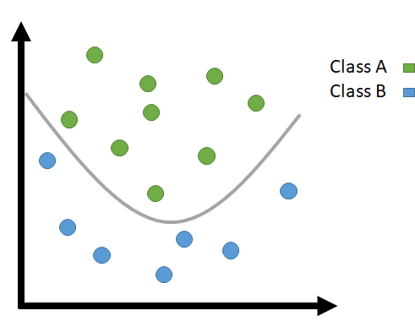
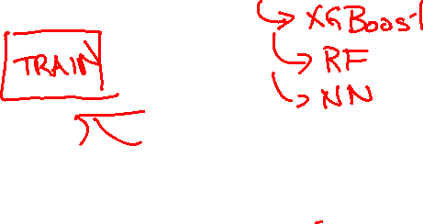
Binary Classification
is the task of classifying the elements of a set into one of two groups (each called class).
Separating Hyperplane
NON-LINEAR

Slide 6
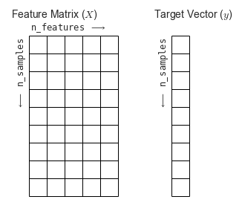
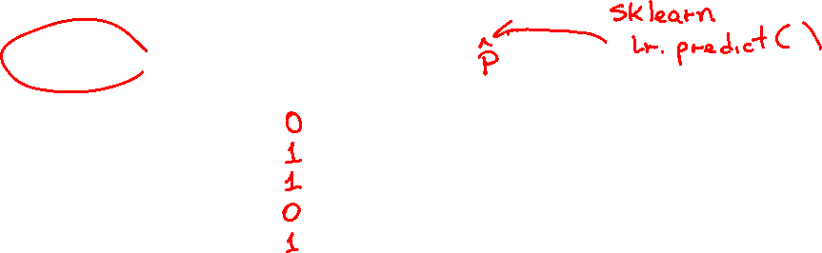
Binary Classification
is the task of classifying the elements of a set into one of two groups (each called class).

Slide 7


Binary Classification - Propensities
Linear and non-linear predictors output the probability of belonging to a particular class ($\hat{p}$)

Slide 8
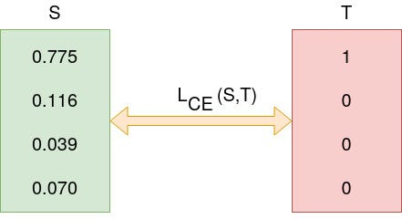
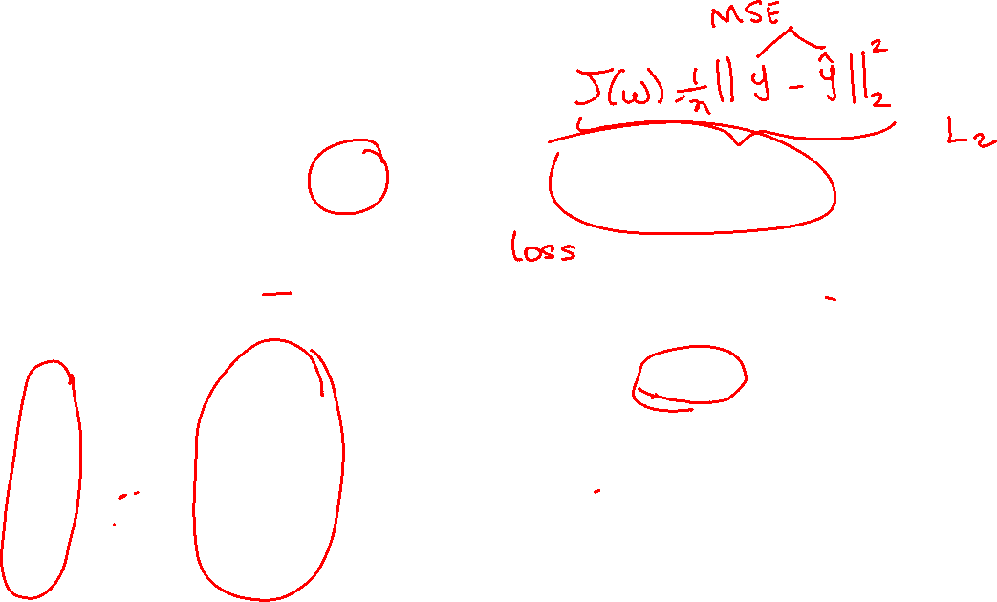
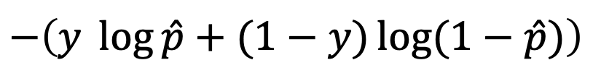


Binary Cross-Entropy
The most common loss function in binary classification
$$−\left(y \log{\hat{p}}+(1−y)\log{(1−\hat{p})}\right)$$
$$y$$
$$\hat{p}$$
How do we determine the distance between this two vectors?

Slide 9
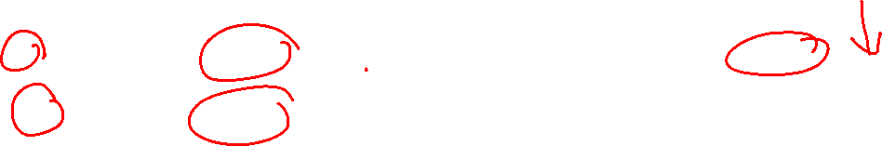
Binary Cross-Entropy
The most common loss function in binary classification
$$−\left(y \log{\hat{p}}+(1−y)\log{(1−\hat{p})}\right)$$
$$y$$
$$\hat{p}$$
$$−\left(1 \log{0.775}+\left(1−1\right)\log\left(1−0.775\right)\right)=0.2549$$

Slide 10

Binary Cross-Entropy
The most common loss function in binary classification
$$−\left(y \log{\hat{p}}+(1−y)\log{(1−\hat{p})}\right)$$
$$y$$
$$\hat{p}$$
$$−\left(0 \log{0.116}+\left(1−0\right)\log\left(1−0.116\right)\right)=0.1233$$

Slide 11
Binary Cross-Entropy
The most common loss function in binary classification
$$−\left(y \log{\hat{p}}+(1−y)\log{(1−\hat{p})}\right)$$
$$y$$
$$\hat{p}$$
$$−\left(0 \log{0.039}+\left(1−0\right)\log\left(1−0.039\right)\right)=0.0398$$

Slide 12
Binary Cross-Entropy
The most common loss function in binary classification
$$−\left(y \log{\hat{p}}+(1−y)\log{(1−\hat{p})}\right)$$
$$y$$
$$\hat{p}$$
$$−\left(0 \log{0.070}+\left(1−0\right)\log\left(1−0.070\right)\right)=0.0726$$

Slide 13
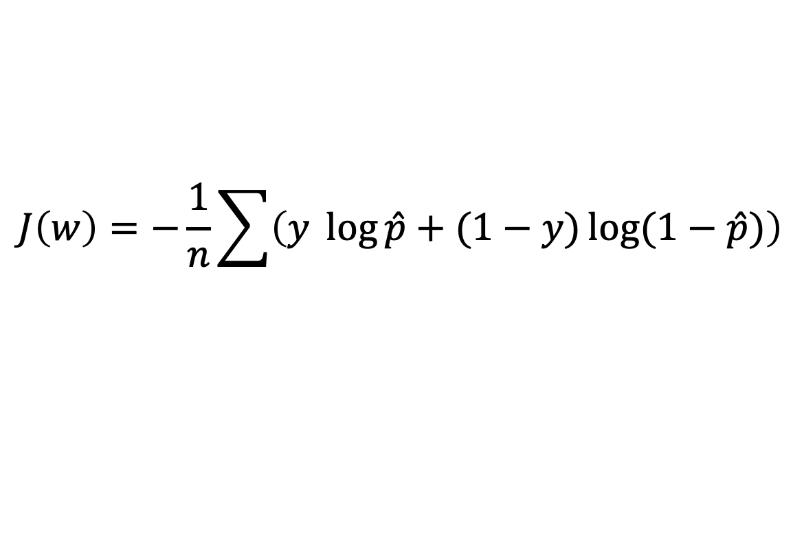

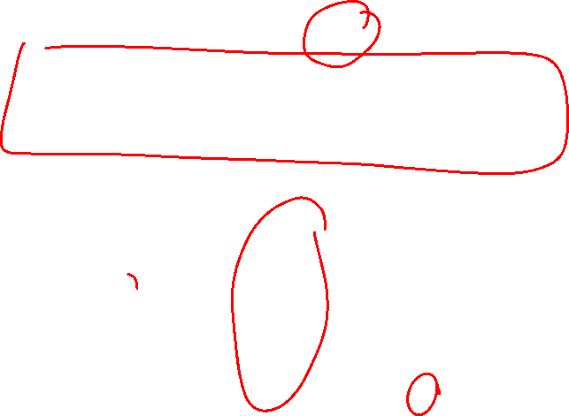
Binary Cross-Entropy
The binary cross-entropy cost function is the average of the losses
$$J\left(w\right)=−\frac{1}{n}\sum{\left(y \log{\hat{p}}+(1−y)\log{(1−\hat{p})}\right)}$$
$$y$$
$$\hat{p}$$
$0.2549$ +
$0.1233$ +
$0.0398$ +
$0.0726$ = 0.4906/4 = 0.12265

Slide 14
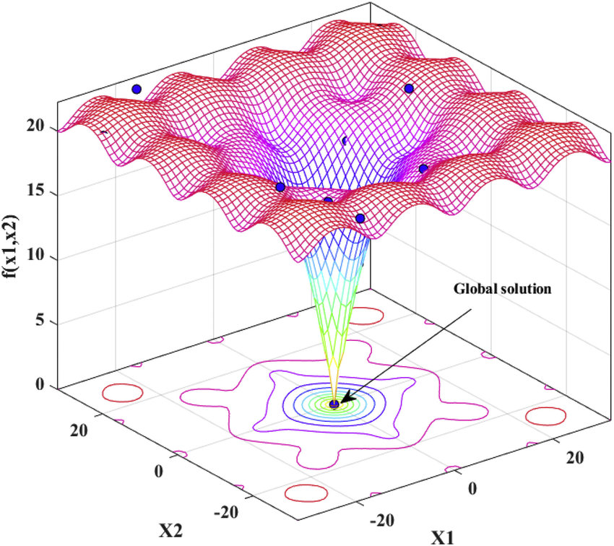


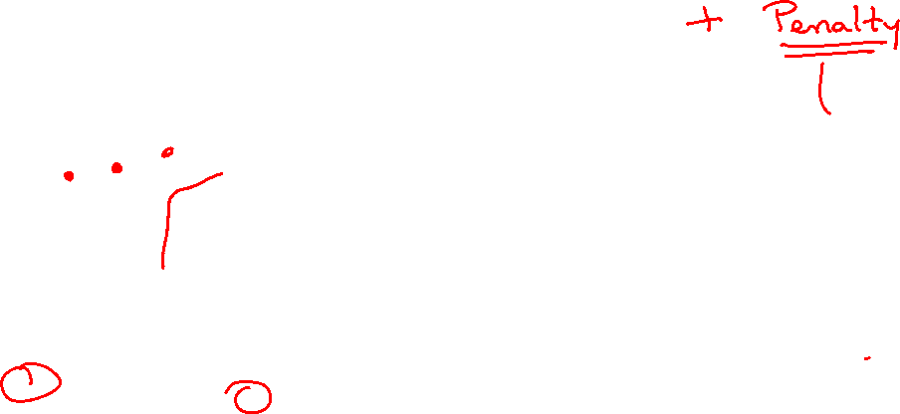

Binary Cross-Entropy
The binary cross-entropy cost function is the average of the losses
$$J\left(w\right)=−\frac{1}{n}\sum{\left(y \log{\hat{p}}+(1−y)\log{(1−\hat{p})}\right)}$$
Example: LOGISTIC REGRESSION
$$\hat{p}= \frac{1}{1+ e^{−(w_{0}+w_{1}x_{1}+ ….)}}=\frac{1}{1+ e^{Xw}}$$
$$J(w)$$
$$w_{0}$$
$$w_{1}$$

Slide 15
Python
Notes:
Guidelines
Use a title slide at the beginning of your presentation. There are 9 variations of title slides to choose from.
If you will have a series of slideshows, we recommend using the same style of title slide for each presentation.
Keep your title to no more than 2 lines.
Do not change the font style or font size of the title or subtitle.

Slide 16
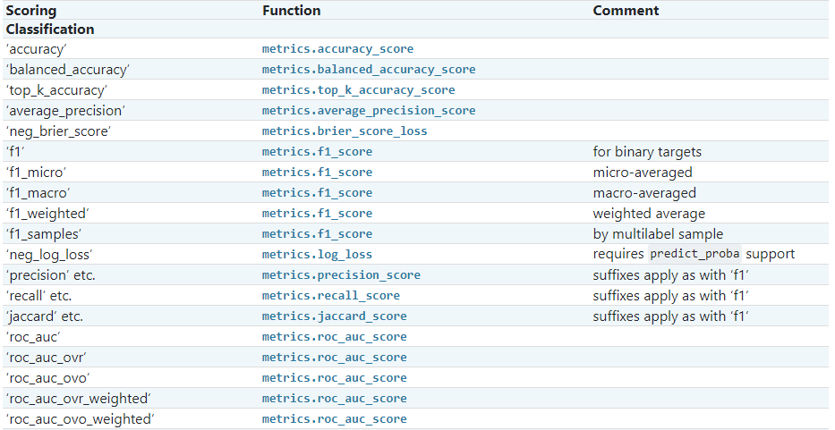

Metrics
Used to determine if model is performing well

Slide 17
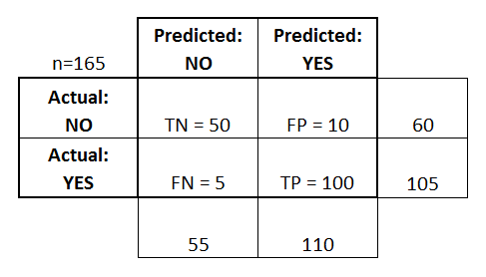




Metrics Review: Confusion Matrix
The confusion matrix gives a summary of overall performance
True Positives, True Negatives, False Positives and False Negatives
$$n_{0,0}$$
$$n_{0,1}$$
$$n_{1,0}$$
$$n_{1,1}$$

Slide 18
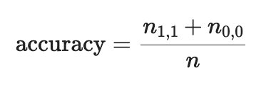

Metrics Review: Accuracy
The accuracy metric measures number of obs predicted correctly
It is one of the most important classification metrics
$$n_{0,0}$$
$$n_{0,1}$$
$$n_{1,0}$$
$$n_{1,1}$$

Slide 19
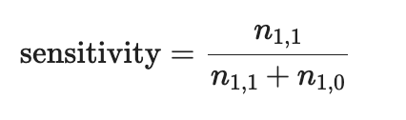

Metrics Review: Recall (Sensitivity)
The fraction of all 1’s that are classified (predicted) as 1’s.
$$n_{0,0}$$
$$n_{0,1}$$
$$n_{1,0}$$
$$n_{1,1}$$

Slide 20
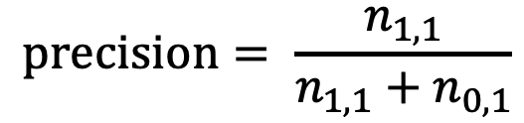
Metrics Review: Precision
The fraction of predicted values that are correct.
$$n_{0,0}$$
$$n_{0,1}$$
$$precision= \frac{n_{1,1}}{n_{1,1}+n_{0,1}}$$
$$n_{1,0}$$
$$n_{1,1}$$

Slide 21
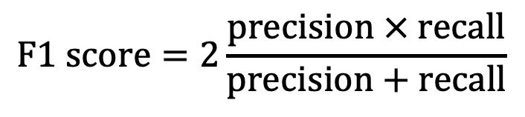

F1 Score
It is meant to capture both Recall and Precision
$$F1 score=2\frac{precision × recall}{precision+recall}$$
$$n_{0,0}$$
$$n_{0,1}$$
$$n_{1,0}$$
$$n_{1,1}$$

Slide 22
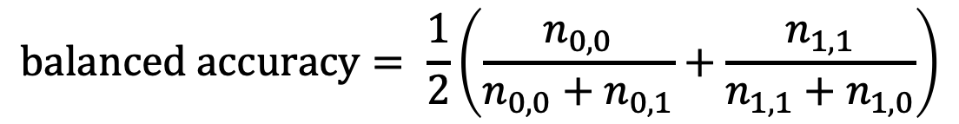
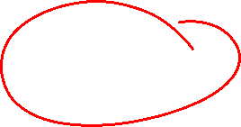
Balanced Accuracy
We use the balanced accuracy for imbalanced data
$$balanced accuracy= \frac{1}{2}\left(\frac{n_{0,0}}{n_{0,0}+n_{0,1}}+\frac{n_{1,1}}{n_{1,1}+n_{1,0}}\right)$$
$$n_{0,0}$$
$$n_{0,1}$$
$$n_{1,0}$$
$$n_{1,1}$$

Slide 23
Python
Notes:
Guidelines
Use a title slide at the beginning of your presentation. There are 9 variations of title slides to choose from.
If you will have a series of slideshows, we recommend using the same style of title slide for each presentation.
Keep your title to no more than 2 lines.
Do not change the font style or font size of the title or subtitle.

Slide 24
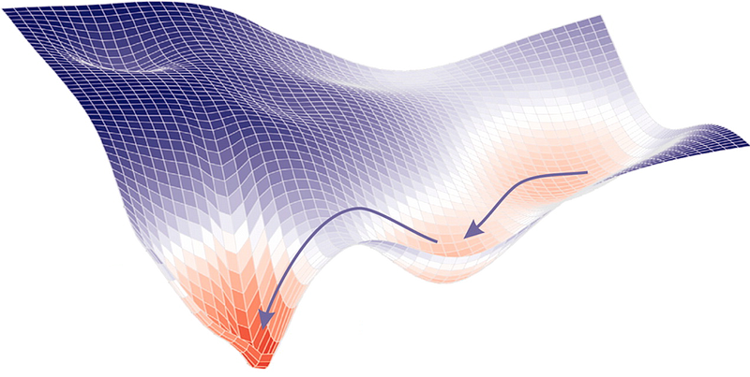

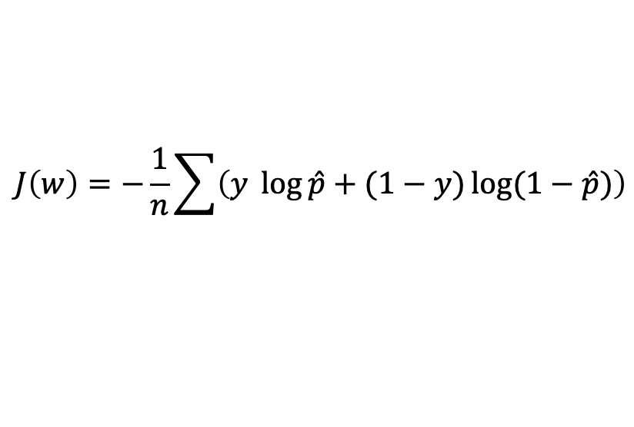
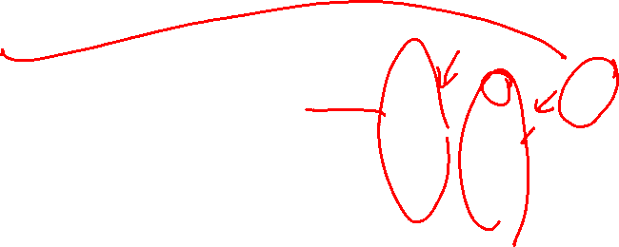

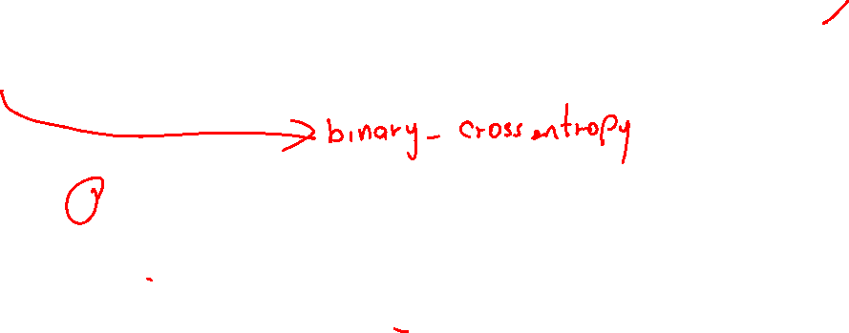
Common Cost Functions Neural Nets
Binary Cross-Entropy
Loss Function
Gradient
$$J\left(w\right)=−\frac{1}{n}\sum{\left(y \log{\hat{p}}+(1−y)\log{(1−\hat{p})}\right)}$$
$∇J\left(w\right)= \hat{p}$ $− y$
$\hat{p}$

Slide 25
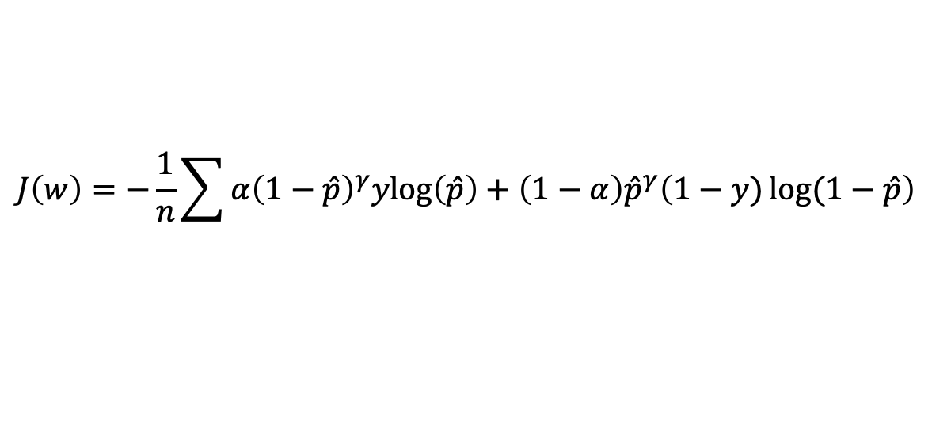
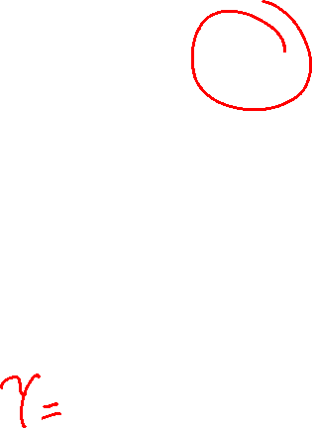
Common Cost Functions Neural Nets
Binary Focal Cross-Entropy
Loss Function
Gradient
$$J\left(w\right)=−\frac{1}{n}\sum{α{\left(1−\hat{p}\right)}^{γ}ylog\left(\hat{p}\right)+\left(1−α\right){\hat{p}}^{γ}\left(1−y)\log{(1−\hat{p}}\right)}$$
$∇J\left(w\right)=(γ(1−y−$ $\hat{p})\log\left(1−\hat{p}\right)+(1−y−\hat{p})\hat{p}(1−\hat{p})$
$\hat{p}$

Slide 26
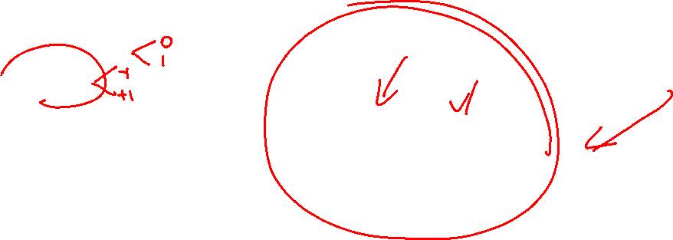
Activation Functions Neural Nets
Common Activations on Layers
ReLu
Tanh
Sigmoid
Output Layer Activation
Sigmoid
Tanh
$\hat{p}$

Slide 27
Python
Notes:
Guidelines
Use a title slide at the beginning of your presentation. There are 9 variations of title slides to choose from.
If you will have a series of slideshows, we recommend using the same style of title slide for each presentation.
Keep your title to no more than 2 lines.
Do not change the font style or font size of the title or subtitle.

